Slide 1
INTRODUCTION TO DATA SCIENCE
SHANKARANARAYANA HEBBAR H S
AMRUTANSHU BHAT

Slide 2
INTRODUCTION
We have chosen Indian cities as our data set. It contains all the states and its cities with total population, population of male and female , literacy rate ,sex ratio etc.

Slide 3
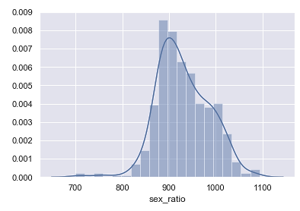
normalization
This is the plot of sex ratio before normalizing the data.

Slide 4
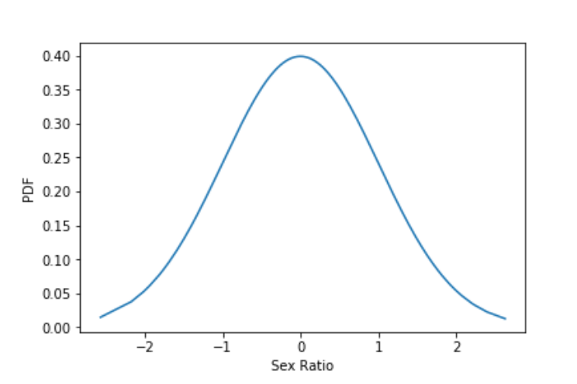
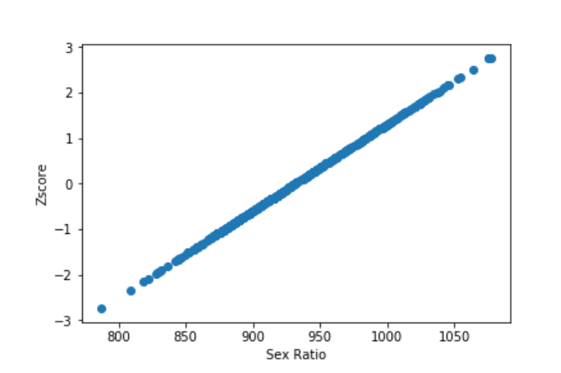
Plot after normalizing of the data. In scattered plot we see that there are few outliers in the data , but many are concentrated at the center.

Slide 5
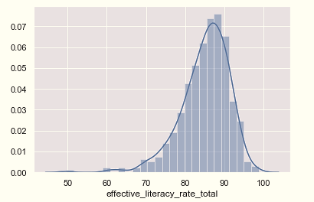
Above plot represent the total literacy rate before normalizing the data.

Slide 6
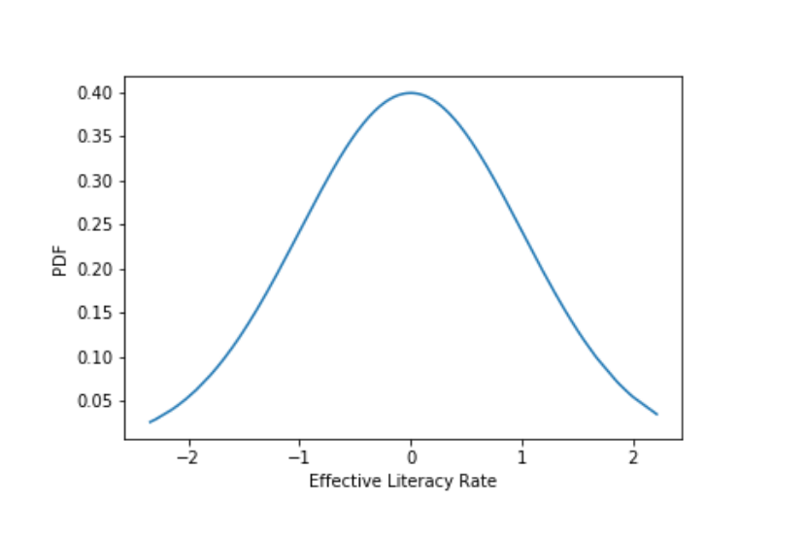
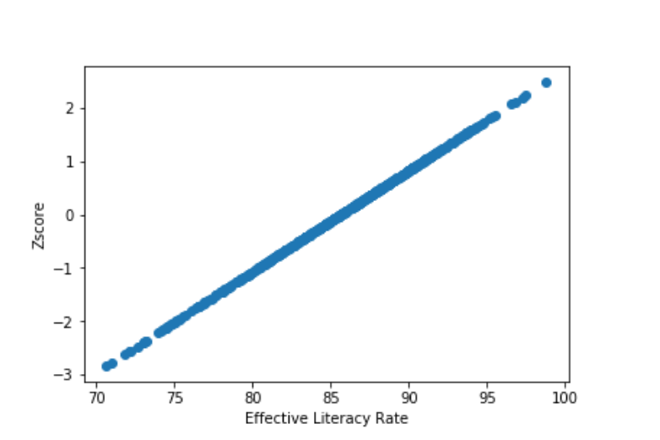

Slide 7
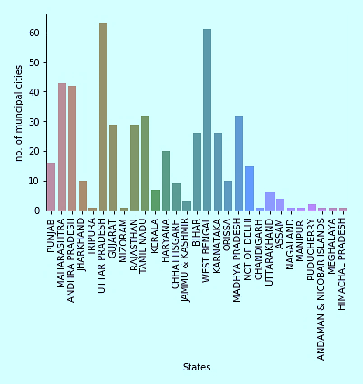
BarGraph:
Bar graph is for discrete data . Figure sows the total number of cities in each states .
In West Bengal and Uttar Pradesh there are maximum number of cities.

Slide 8
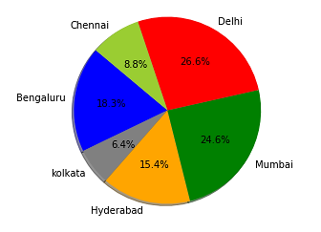
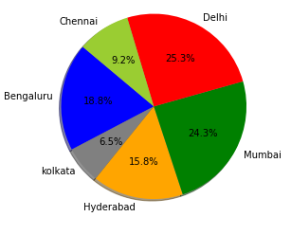
PIE CHART OF MATROPOLIAN CITIES:
Above pie chart represent the population of male and female aged below 6 years . From both the plot male population is more except Kolkata and Delhi has the highest population.

Slide 9
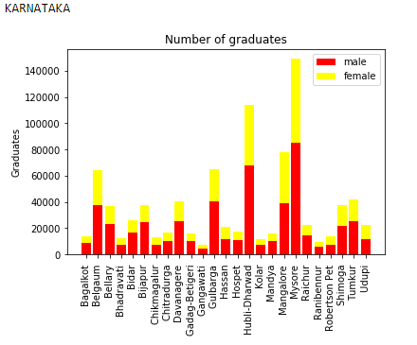
Stacked Bar graph:
Yellow represents the total female graduates whereas red indicates male graduates.
Length of the bar is the total number of graduates
From the graph we can observe that Mysore has highest graduates.
We can also analyze that in every district male graduates are more than the female.

Slide 10
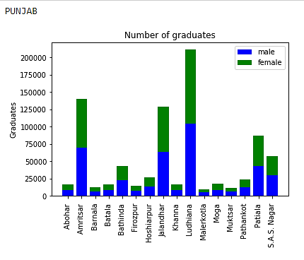
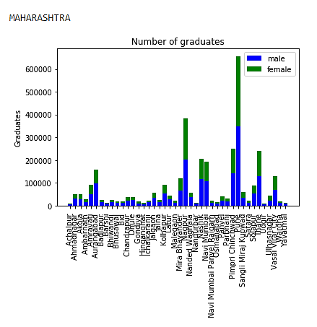
In Punjab number of male and female graduates are almost same .
But in Maharashtra also male graduates are comparatively high.

Slide 11
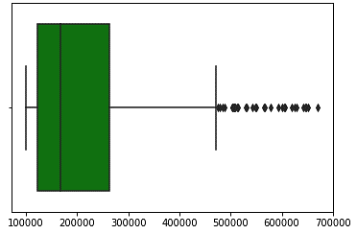
BOX PLOT:
this box plot represent the total population in the cities.
We can see many outliers in this plot since the cities like Mumbai , Bangalore ,
Hyderabad etc. has large amount of population.
But most cities has the population less than 200000 so median is concentrated towards the left of the plot.

Slide 12
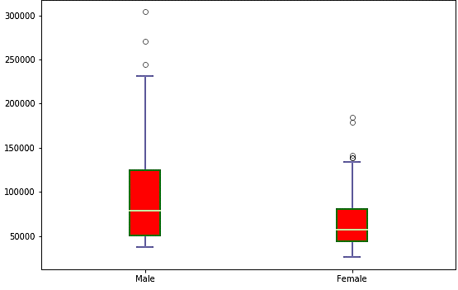
Above box plot shows the literates of all the cities. In case of male literates we can observe more number between 50000-125000.There are few outliers up to 300000.Median is not at the center of the plot which indicates there are maximum number of cities have literates below 75000.Coming to another plot we can see there are less number of female literates compare to male with mean almost equal to 60000.There are more outliers in female literates.

Slide 13
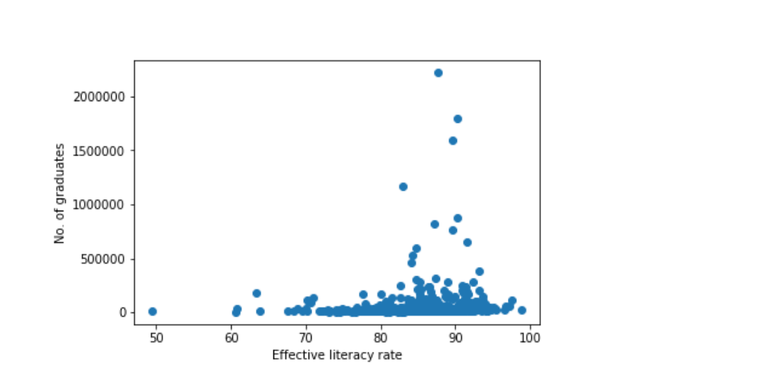
CO-RELATION:
This says effective literacy rate and no. of graduates are less related, that means we can’t say that if the literacy increases number of graduates increases.

Slide 14
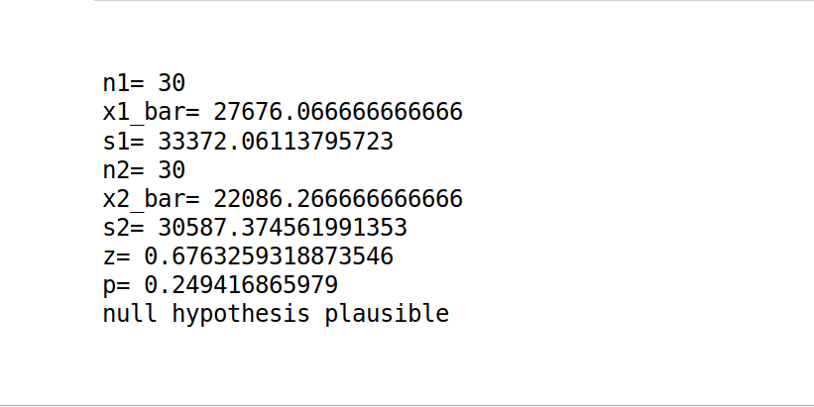
HYPOTHESIS TESTING:
H0: Male graduates is less than or equal to female graduates .
mu1<=mu2
H1:Male graduates is more than female graduates .
mu1>mu2
It is right tailed z-test
From this we can say that it is plausible that female graduates are more in most of the cities than the male graduates, at 5% level of significance

Slide 15
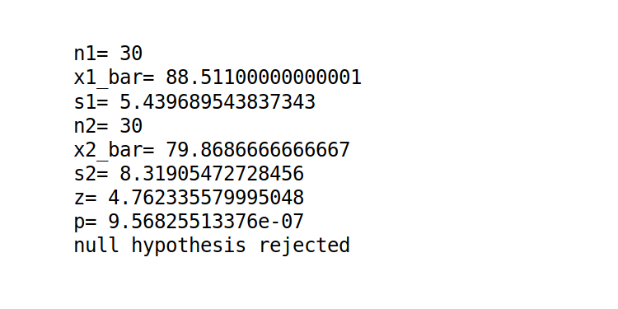
H0: Male literacy rate is less than or equal to female literacy rate .
mu1<=mu2
H1:Male literacy rate is more than female literacy rate .
mu1>mu2
It is right tailed z-test
From this we can say that male literacy rate is more in most of the cities than the female literacy rate at 5% level of significance

Slide 16
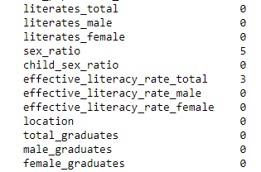
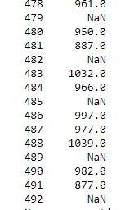
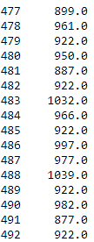
DATA CLEANING:
Image shows the total number of missing values in different columns . we can see that there are total 8 missing data.
NaN in the image represent the missing value in sex_ratio column.
This is the image after cleaning the data . Missing value is replaced by the median . This replaced value is similar to that of other values in the table.

Slide 17
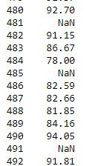
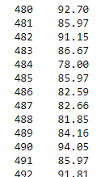
This is the image of the column total literacy rate .There are 3 missing values .
So this missing value is replaced by the median of the data which is 85.97.
This replaced value is also matches with the other data members.

